Slide 1
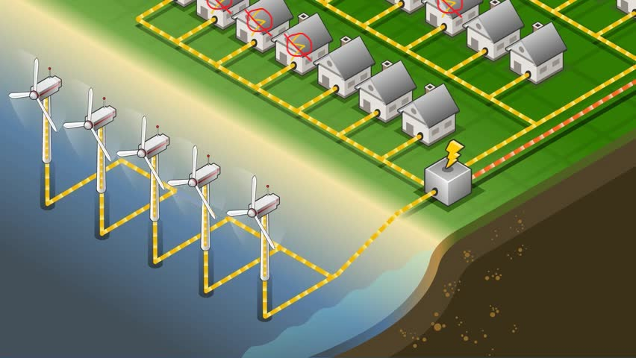
Modernizing the Electric Grid
Solutions
Modernize the electric grid by building more high-capacity transmission lines
Increase reliability by making microgrids
Problems with the electric grid
Lack of capacity
Lack of reliability
Benefits
New high-capacity transmission lines allow the utilization of renewable power in low demand areas to power high demand areas
Implementing microgrids in areas where they are reasonable allow them to operate even while the surrounding region has a blackout
Implementation
Survey estimated energy requirement changes nationwide
Build new high-capacity transmission lines with current transmission lines and known renewable resources in mind
Replace obsolete transmission lines
Survey current and estimated growth in residential and commercial solar
In reasonable areas, build microgrids

Slide 2
Works Cited
“2020 Population Distribution in the United States and Puerto Rico.” United States Census Bureau, 19 Oct. 2021, https://www.census.gov/library/visualizations/2021/geo/population-distribution-2020.html.
Dillon, John. “Transmission Grid Bottlenecks in Northeast Kingdom Stall Solar Development.” Vermont Public, 17 Dec. 2020, https://www.vermontpublic.org/vpr-news/2020-12-15/transmission-grid-bottlenecks-in-northeast-kingdom-stall-solar-development.
“Intertie.” Northwest Power and Conservation Council, https://www.nwcouncil.org/reports/columbia-river-history/intertie/.
Lopez, Anthony, et al. “U.S. Renewable Energy Technical Potentials: A GIS-Based Analysis - NREL.” National Renewable Energy Laboratory, July 2012, https://www.nrel.gov/docs/fy12osti/51946.pdf.
Matthew Brown, Camille Fassett. “Storms Batter Aging Power Grid as Climate Disasters Spread.” AP NEWS, Associated Press, 6 Apr. 2022, https://apnews.com/article/wildfires-storms-science-business-health-7a0fb8c998c1d56759989dda62292379.
Seltzer, Molly, and Andlinger Center for Energy and the Environment. “Big but Affordable Effort Needed for America to Reach Net-Zero Emissions by 2050, Princeton Study Shows.” Princeton University, The Trustees of Princeton University, 15 Dec. 2020, https://www.princeton.edu/news/2020/12/15/big-affordable-effort-needed-america-reach-net-zero-emissions-2050-princeton-study.
“Solar Industry Research Data.” Solar Energy Industries Association, https://www.seia.org/solar-industry-research-data.
Wood, Elisa. “Microgrids Help Texas as It's Forced to Undertake Rolling Blackouts.” Microgrid Knowledge, 28 Aug. 2021, https://microgridknowledge.com/microgrids-texas-blackouts/.

